Slide 1
Growth and Characterization of CoTb magnetic thin films

Slide 2
Introduction to CoTB thin films
Notes:
What are thin films and what are they used for?
Magnetic thin films consisting of metallic alloys are of particular interest for data recording and spintronic applications.
More specific what properties do they have and what materials are used?
CoPt is highly used for many technological applications such as ??? This is because it has distinct repeating magnetic domains with a size of several hundreds of nanometers
which are showing maze- or stripe domains depending on how it has been demagnetized. This is partly because CoPt has a strong anisotropy and therefore a difference between the in plane and out
of plane magnetization.
What more within the field are not known?
Due to the lower Curie temperature of CoTb, one wants to obtain the same properties using this alloy for thin films. Further, the domain wall dynamics is expected to be much
more interesting than for CoPt. However, not enough research has been performed on CoTb thin films in order to state the optimal configuration for repeatable synthesize.
But for in order to use it within many technological applications we need to get a complete understanding of the relationship between growth parameters, final structure and magnetic properties is required to achieve the desired functionality.

Slide 3
Goal of the internship
Notes:
What is the goal of the internship?
The aim of this project is to systematically optimize the growth conditions of CoTb (cobalt terbium) alloy thin films for obtaining perpendicular magnetic anisotropy PMA and magnetic domains [5]. To
do so, we will play with different parameters such as alloy composition, thickness, pressure, cleaning, and buffer layer. The synthesis of the thin films was performed by DC magnetron sputtering and the
characterization was performed using MOKE, AFM, EDX, and SEM. The MOKE and the magnetron are located at the Laboratoire de Chimie Physique Mati`ere et Rayonnement (LCPMR) [6]. AFM,
EDX, and SEM were done at the Institut des NanoSciences de Paris (INSP).

Slide 4
How the presentation is organized
Notes:
How are the presentation organized?
In order to understand why we did like we did and what the results showed, I will give a brief introduction to the background. This is a very advanced topic and I cannot go into too much detail??
-Magnetic moments + fields
Interactions
Domains
Domains in thin films (rare earth elements and transition metals)

Slide 5
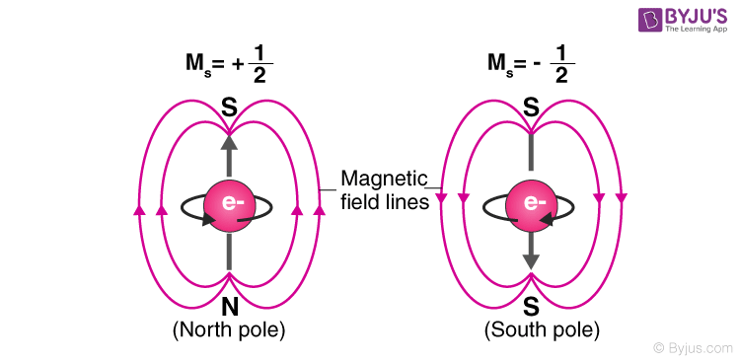
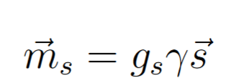
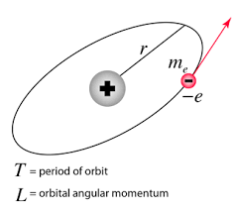
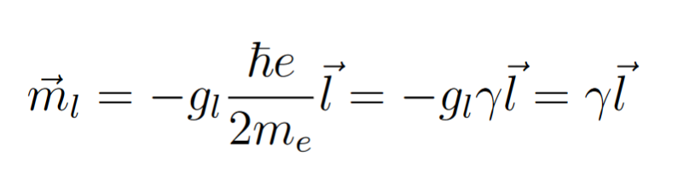
Magnetic moments of electrons
Spin magnetic moment:
Angular momentum magnetic moment:
Notes:
It is the electronic configuration of the atoms which determines the magnetic properties in a material. Some electronic configurations will give rise to a magnetic moment in each atom because electrons
posses spin- and orbital angular momentum.
What is the difference between spin- and angular momentum and spin and angular magnetic moment?

Slide 6
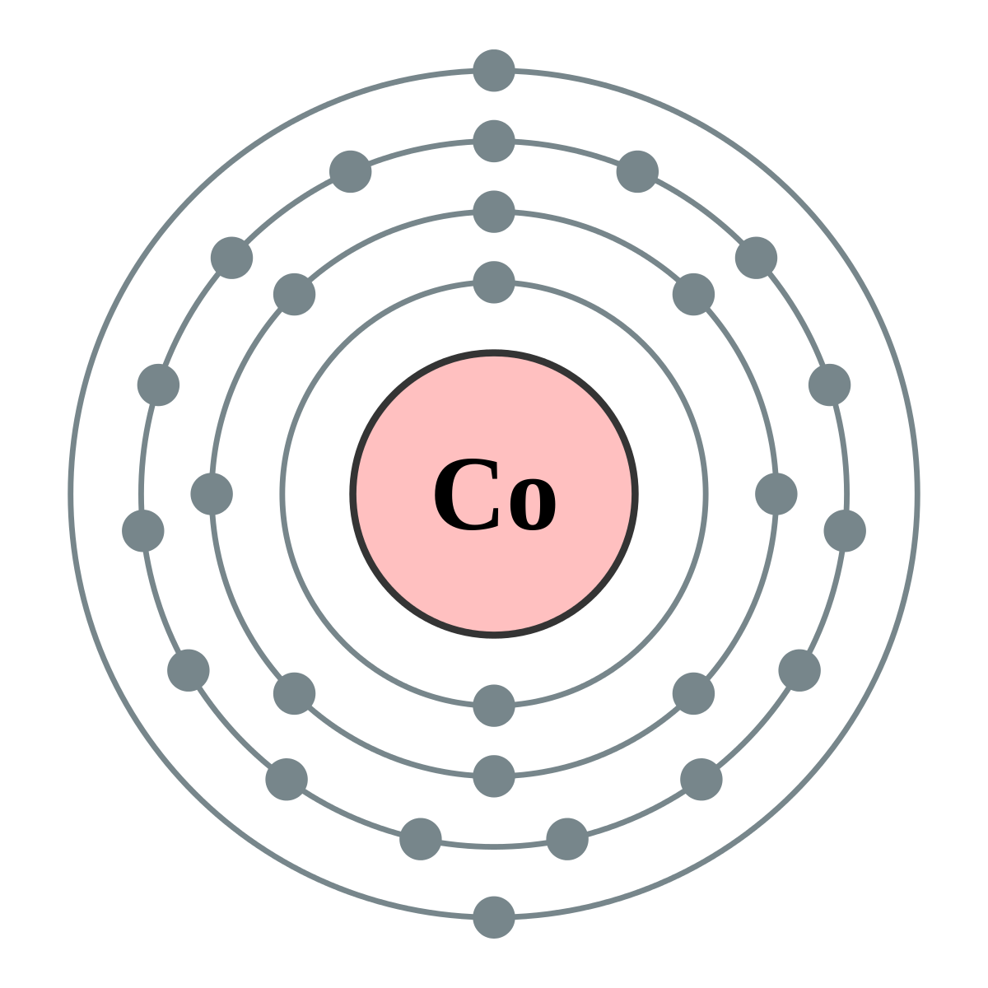

Magnetic moment of Atoms
Notes:
Vector sum of the spin- and angular magnetic moment of conduction /unpaired electrons contribute to the magnetic moment of an atom. When a large collection of atoms all have a magnetic moment one can define the vector field, ⃗M, which is the magnetic moment pr. unit volume [4].

Slide 7
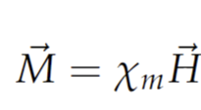
Classification of magnetic materials
Notes:
The
classification of magnetic materials is determined by their response to an external magnetic field, ⃗H. The material respond because it tries to minimize the energy of the system

Slide 8
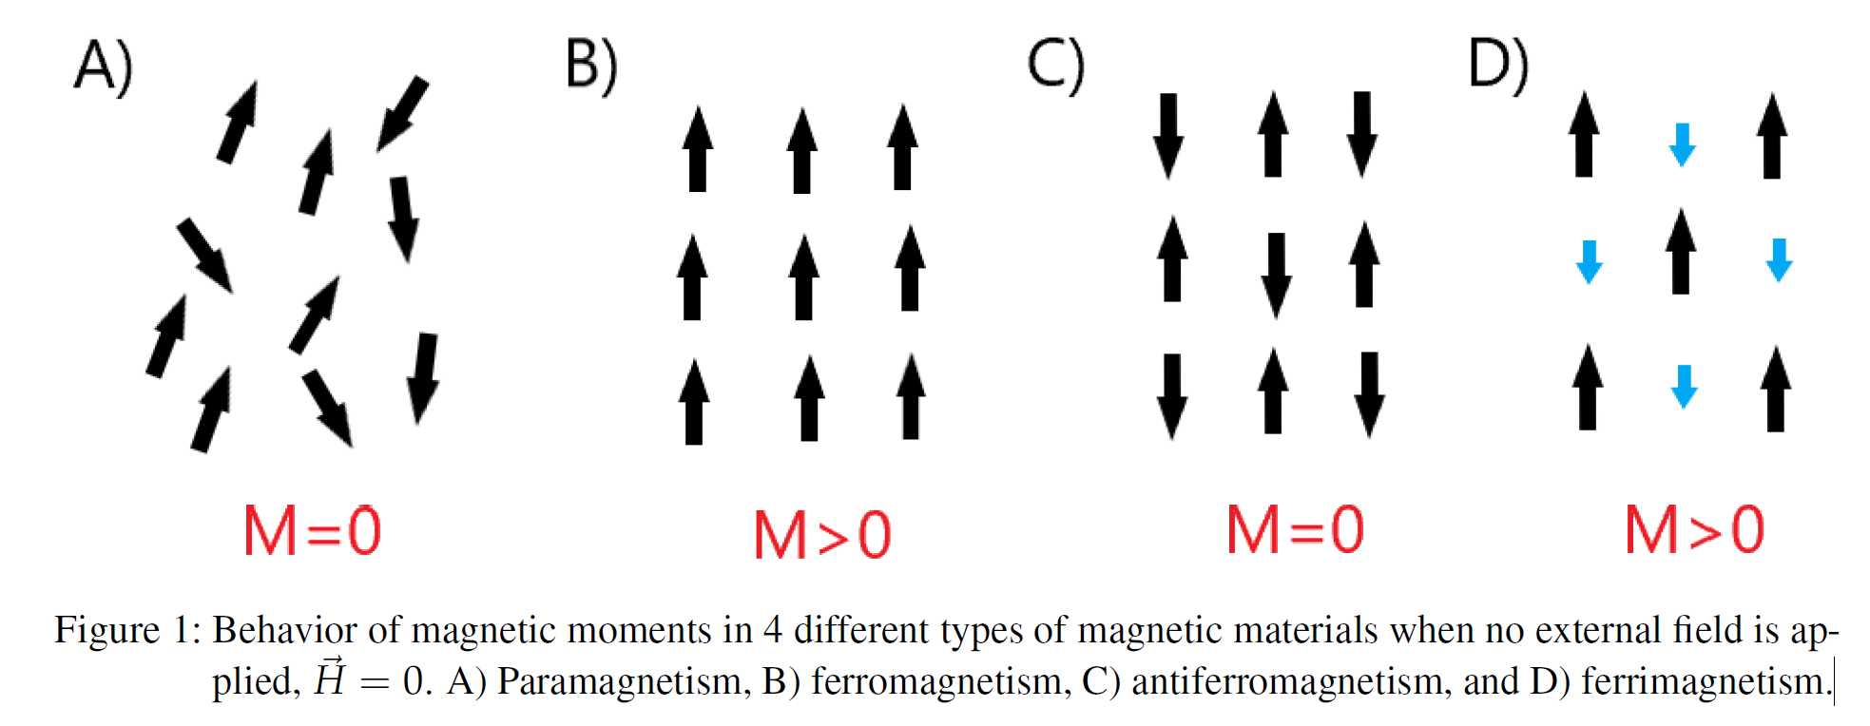
Magnetic materials
Notes:
Diamagnetism is a weak quantum mechanical property found in any material. When a magnetic field is present, the electrons will try to oppose the field by changing their orbital motion which leads
to an induced opposite magnetic field [4]. However, it is only the dominant response when all the electrons in the material are paired, as it will induce a zero net magnetic moment. When there is
an uneven number of electrons, meaning you have at least one unpaired electron in each atom, a non-zero magnetic moment will arise, leading to stronger interactions. In that case we talk about
paramagnetism. In these materials, the magnetic moments are aligned randomly in the absence of a magnetic field as seen in fig. 1 A). When a magnetic field is applied, the electrons will align to the
magnetic field leading to a momentarily magnetic material [8]. In contrast, in ferro-, antiferro- and ferrimagnetic systems, the magnetic moments display ordered configurations in the absence of an
external magnetic field as shown in fig. 1 B), C), and D) [7]. These phenomena arise due to unpaired electrons but unlike for paramagnetism, the interaction between spins, called the exchange interaction,
is much greater. In a moment i will talk about all the different interactions – but first i would like to present for you the hysteresis of different cases. The exchange interaction makes the magnetic moments point in a specific direction.
In ferromagnetic materials all the magnetic moments are aligned parallel while for antiferromagnetic
materials their alignment is antiparallel [4]. In ferrimagnetic materials, you have some of the magnetic
moments parallel and some antiparallel which often occurs in materials containing two or more types
of atoms, i.e. alloys. When the two opposite magnetizations do not cancel, there will be a net magnetic
moment in one direction. This net magnetic moment depends on the composition of the alloy. The
size of the exchange interaction is dependent on the overlap integral between the spins and evolves with the temperature.

Slide 9
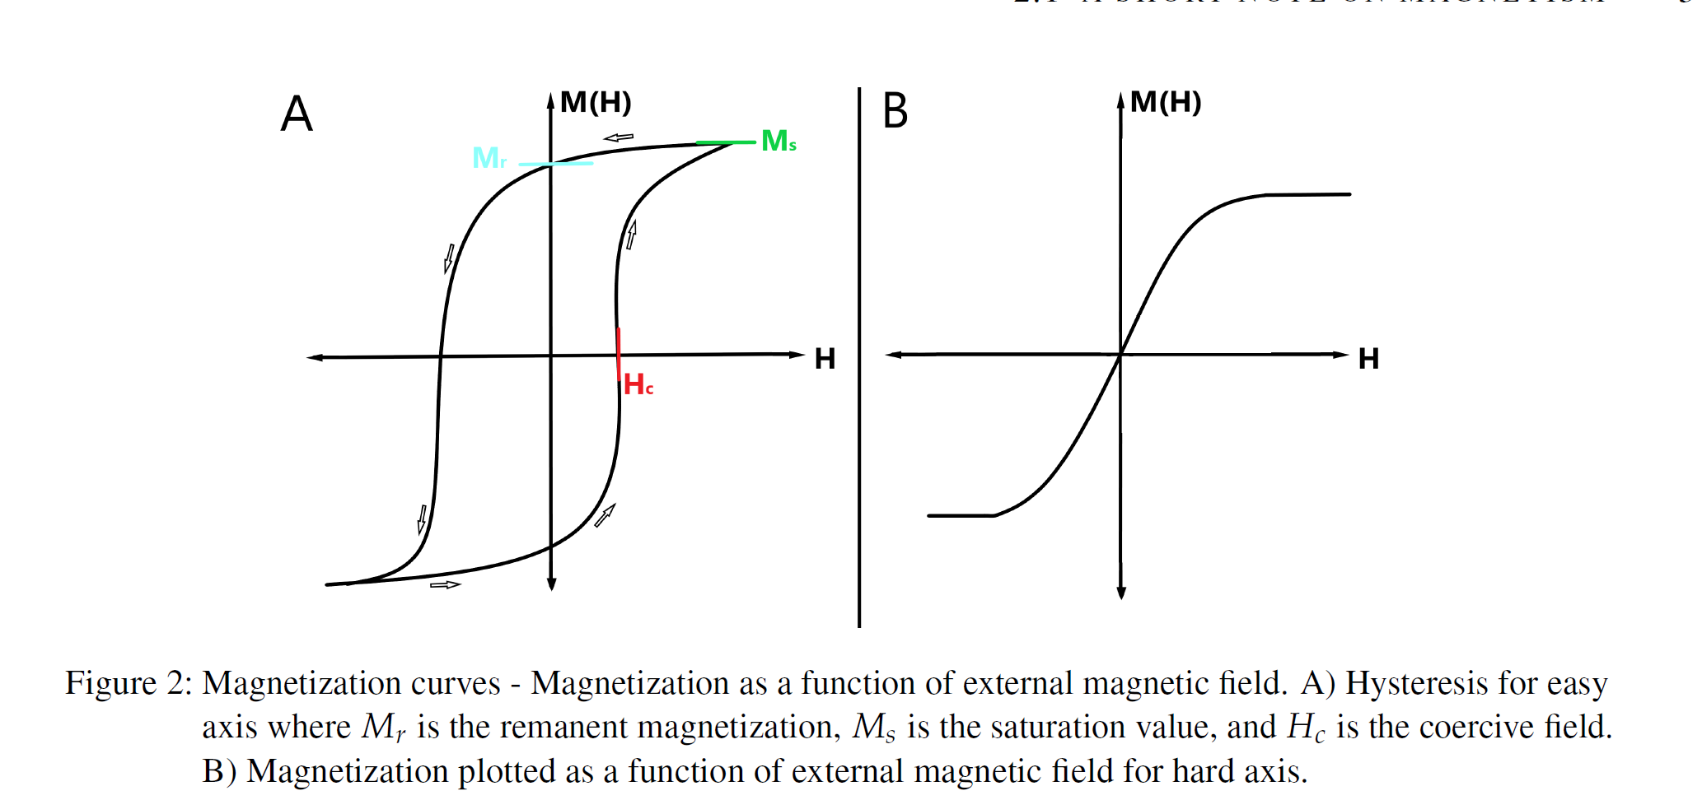
Magnetization curves
Notes:
For a uniaxial material, the axis along the net magnetization is called the easy axis while the axis perpendicular to it is called the hard axis. To characterize a magnetic material, magnetization curves can be measured to know how the system behaves when an external magnetic field is applied in a certain direction.
Ferromagnetic materials display hysteresis behavior, where the state of the system depends on its history. Typical magnetization curves for ferro- and ferri-magnets are shown in fig. 2 A) and B). Figure 2 A) is a typical hysteresis curve measured along the easy axis, with Hc being the coercive field found when M(H) = 0 and telling you how hard the magnetization of the sample is. Large values of Hc means that the magnet can resist a great external magnetic field without being influenced by it. At H = 0 you find Mr which is the remanent magnetization and is a measure of the strength of the magnetization when the magnetic field is absent. Ms is the saturation value which is the upper limit for magnetization of the given material [12]. Fig. 2 B) shows a typical graph where the magnetization is plotted as a function of a magnetic external field applied along the hard axis. The curve is somewhat linear and there is no hysteresis and therefore no coercive field. This is because along the hard axis, the magnetization is proportional to the external magnetic field and therefore near zero in the absence of a magnetic field.

Slide 10
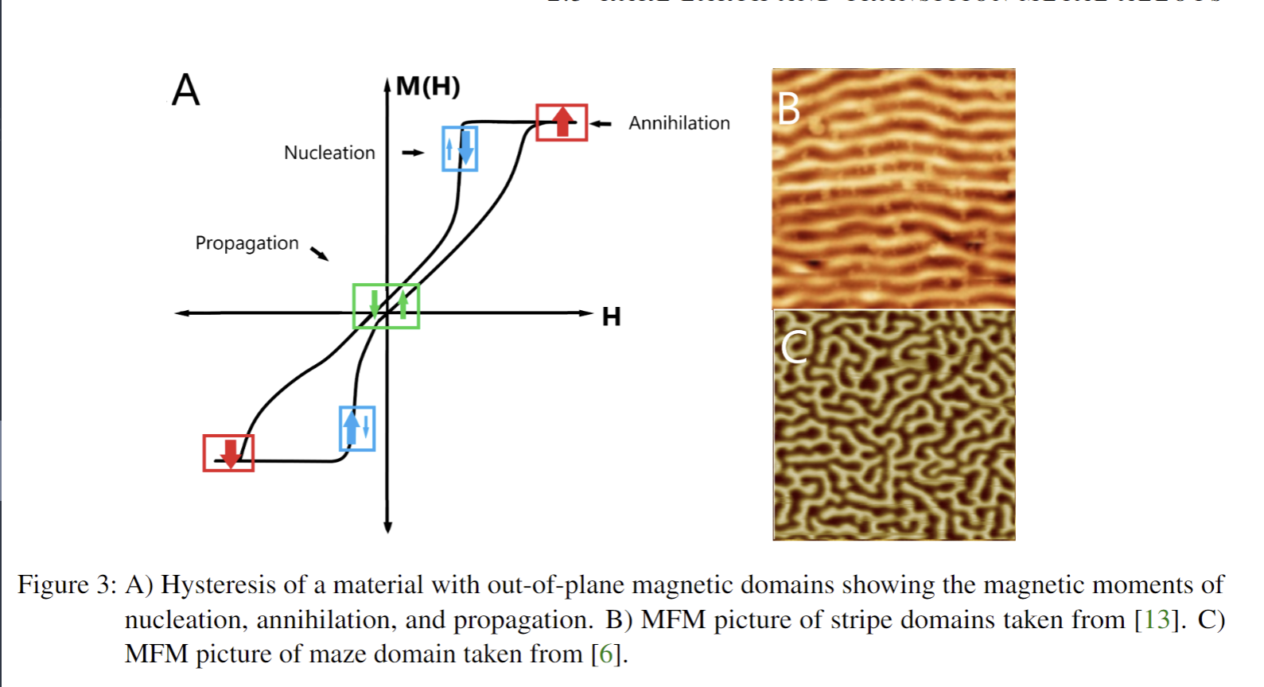
Domains and formation
Notes:
As said previously, the goal of the internship is to find distinct repeating magnetic domains with a size of several hundreds of nanometers
which are showing maze- or stripe domains depending on how it has been demagnetized.
What is domains?
In ferro- and ferri magnetic thin films the magnetic moments point in the same direction. However, looking at the microscopic scale this is not always true throughout the whole surface but only in small areas, called domains. In two domains, the spins are aligned in different directions, called up or down, and are separated by a domain wall [9]. On a large scale, all the domains in a material can cancel each other if there is an equal number of domains pointing in one way as the other. Therefore, it is possible for a ferromagnetic material to have no overall magnetization [4].
What are the origin of the domains?
The origin of the domains is due to many different interactions at play. The state of the magnetic moments in a material will always be the one which favours the least energetic configuration. In the following, we briefly introduce the different contributions to the magnetic interactions in a metal and how they are minimized.

Slide 11
Dipole dipole interactions

Slide 12
Spin orbit coupling

Slide 13
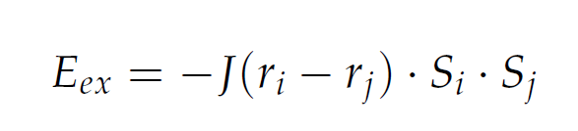
Exchange interaction
Notes:
Spin-spin interaction
The exchange energy is a short ranged interaction between spins. It originates from the Coulomb interaction and the Pauli exclusion principle and is given by equation 2. Here J is the overlap integral for the 2 wave functions and Jij is the exchange constant between the two spin moments Si and Sj of the spins with distance ri − rj between them.
How is the energy minimized?
For positive values of J, the energy is minimized when the spins are parallel and for negative values of J, the energy is minimized when the spins are anti-parallel. The exchange energy is competing
with the excitation of spin magnetic moments. The energy of the excitation is proportional to: kB ・ T [9] where kB is the Boltzmann constant. Above the Curie temperature Tc the energy of the
excitation will win over the exchange interaction making the sample paramagnetic as mentioned above.

Slide 14
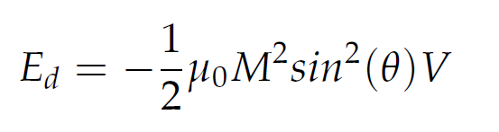
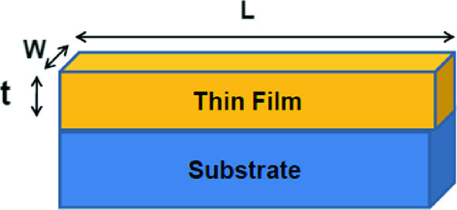

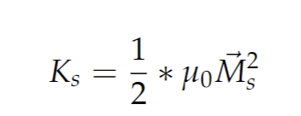
Shape anisotropy or magnetostatic energy
Notes:
Magnetic moment M and demagnetizing field - (sample and atoms)
Interaction between the stray field and the sample. The magnetic moment of the atoms will create a field of the sample in the opposite direction of the magnetization which is why it is called the demagnetization field (dipolar field). Depend on the shape of the material.
Because of their net magnetization, ⃗ M , ferro and ferri-magnetic solids produce their own magnetic field called the demagnetization field or stray field, ⃗ Hd. The net magnetization and the demagne- tization field points in opposite directions [10] and are able to interact with each other.
When an external magnetic field is applied, ⃗ H, the demagnetizing magnetic field, ⃗ Hd, respond by altering the magnetization [4].
The demagnetizing field give rise to shape anisotropy or magnetostatic energy which results in some materials having a preferred direction of magnetization and therefore respond differently depending on the orientation of the magnetic field applied. For a uniaxial material, the axis along the net magnetization is called the easy axis while the axis perpendicular to it is called the hard axis [11].
For a uniaxial material, the axis along the net magnetization is called the easy axis while the axis perpendicular to it is called the hard axis [11]. Changing the direction of magnetization between those two axis therefore cost energy and give a measure of this anisotropy, usually defined as the constant Kz. In this project, we are working with magnetic thin films, for which Ks is given by 1 where μ0 is the vacuum permeability and Ms is the saturation magnetization.
How is the energy minimized?
– rotates the magnetic moments – thin films

Slide 15
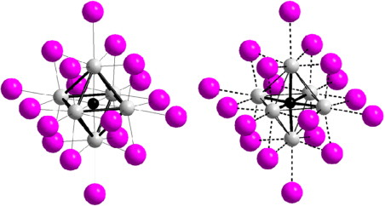
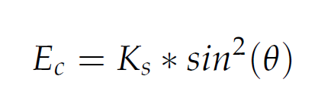
Crystal field
Notes:
The magnetocrystalline interaction is between magnetic moments, ⃗M and the electric field produced by the lattice called the crystal field. The crystal field is a potential which the delocalized electrons
can feel due to positively charged atomic cores. The magnitude is given by eq. 4 where Ks is the anisotropy constant defined earlier 1 and θ is the angle between the magnetization vector and the axis
of easy magnetization.

Slide 16
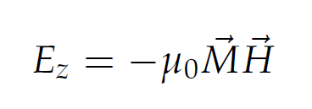
Zeeman interaction
Notes:
The Zeeman interaction describes the interaction between the magnetization, ⃗M and an external
magnetic field applied. The size of the Zeeman interaction is given by eq. 5 where ⃗M is the
magnetization of the material and ⃗H is the external magnetic field applied. The Zeeman interaction is
minimized when the magnetization is parallel to the external magnetic field applied

Slide 17


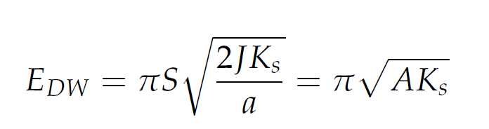
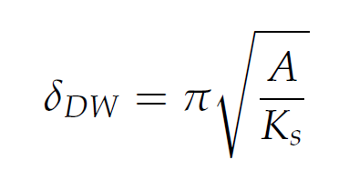
Type of interactions -> energies
Dipole dipole interaction – spin spin? – very small only have an impact at around 0 K.
Spin orbit coupling (spin and the orbital of the atom) – rotates the spins.
Exchange interaction (spin-spin interaction)
Stoner model
Atom
Shape anisotropy or magnetostatic energy (Magnetic moment M and demagnetizing field)
Crystal
Magnetocrystalline interaction – magnetic moment and electric field of lattice
External field
Zeeman interaction (magnetic moment and an external magnetic field)
Formation energy
Domain wall formation energy
- Thickness
Notes:
As said previously, the formation of domains will mainly arise due to the minimization of all the above contributions. As a consequence of formation of domains: the domain wall formation energy
can be expressed as in eq. 6. This energy describes the cost to have 2 areas with each their own direction of magnetic moments [4], with Ks being the anisotropy constant and A the exchange constant
also called stiffness
- Dipole dipole interaction – Very small and we will not really talk about them
The same goes for spin –orbit interaction
Zeeman effect does not change the domain size or formation but can rearrange them depending on how strong an external field which are applied?

Slide 18
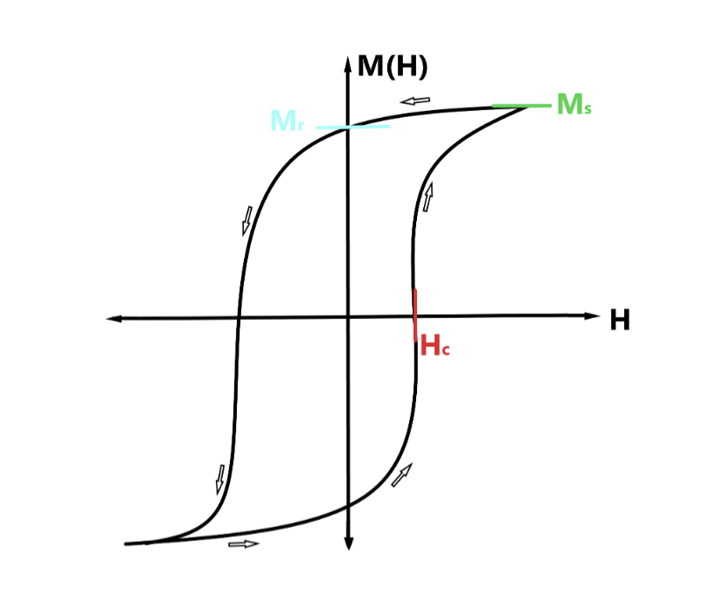
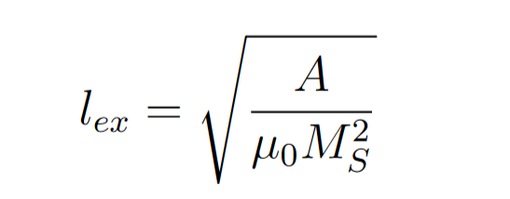
Formation of domains
Exchange interaction (short range) E_ex
vs. - only defined in materials with domains
Magnetostatic energy (crystal) (long range (throughout the sample??) ) E_dip
Who wins depend on Exchange constant A - stifness (the size of it) and saturation of magnetization M_s
Domain wall energy:
Sampels which are larger than l_s favors domains
- we have a lot of Co where the electrons are delocalized -> so E_dip are stronger!
Then the domains are formed but what about Co And Tb together?

Slide 19
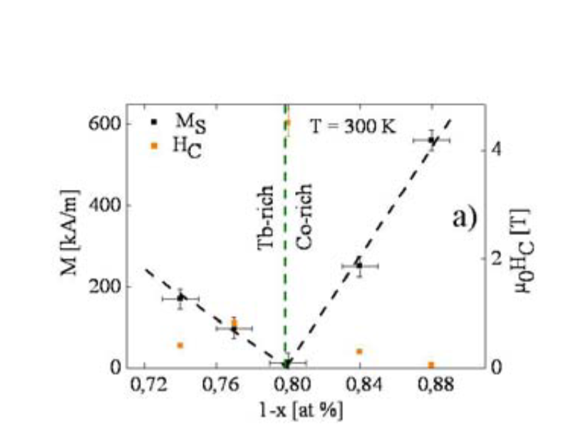
Rare Earth and Transition metal
Transition metal:
- spin + orbital momentum couples to the crystalline lattice (because they are delocalized) -> decouples to each atom -> strong for lattice-orbit ->quenching -> no orbital angular momentum -> J=S. -> magnetization due to spin.
Rare earth elements: Strong anisotropy. (temperatures below Curie Temperature)
->localized -> crystalline lattice small -> weak coupling -> no quenching -> contributions for both spin and angular momentum J = L+S
CoTb together-> ferrimagnetic material -> antiparallel spins -> overall magnetic moment in 1 direction depending on the composition.
Terbium ´has a stronger magnetic moment.
Around 80 Co 20 Tb -> they will cancel each other?
Notes:
Cobalt (Co) is a transition metal (TM) located in the d block in the periodic table. It has delocalized electrons and is a band ferromagnetic material that can be described using the Stoner model. Its magnetic moment at room temperature is typically around 1.7 μB (Bohr magneton) [14]. and the Curie temperature is around 1400K.
Terbium (Tb) is in the f8 block which makes it a rare earth element (REE). The 4 f electrons are localized on each atom and are therefore not shared amongst the other atoms. Tb has a very high anisotropy which means it has a preferred direction of magnetization, and a high magnetic moment around 9.5 μB [15]. However, its Curie temperature is under room temperature (237 K) [10]. Which means that the exchange interaction
When mixing Co and Tb which are a TM and a REE, respectively, interesting magnetic proper- ties arise. This alloy allows to couple Curie temperature above room temperature as well as a high magnetic moment, making it very interesting for devices. Furthermore, their mixing upon sputtering condition creates a strong out of plane anisotropy partially due to the high anisotropy of Tb. Depending on the composition of Co and Tb in CoTb alloy, the magnetic properties will be different [16].

Slide 20
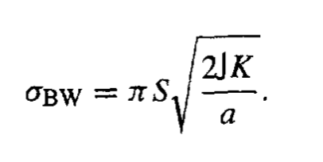
Domains – minimizing the energy
Ferro and ferri materials, the magnetic moments point in the same direction, not throughout the sample, but in areas called domains. The origin of the domains is due the different interactions at play -> want to minimize the magnetic energy of the different contributions.
Exchange interaction: -> uniform magnetization throughout the sample
Magnetostatic energy – dipolar – Shape minimize the demagnetizing field -> orientates the magnetic moments.
Magnetocrystalline interaction -> magnetic moment aligned with crystalline axis
Zeeman effect -> magnetic moment aligned with magnetic field.
The domain wall formation energy (due to the different orientation of the spins) - >

Slide 21
Thin films the magnetization is in plane.
Interaction between co and tb
Simpel thin film iron -> magnetization is aligned in plane. Shape anisotropy. No favorite direction in plane.
Out of plane because of the magnetocrystalline contribution -> E=K*V
Adding Tb to Co, breaks the Co crystalline symmetry and -> magnetocrystalline will lead to an out of plane anisotropyt,
Metallic bonding

Slide 22
Techniques and fabrication of thin films
- Magnetron sputtering
Characterization
MOKE, AFM, EDX, SEM
Notes:
The aim of this project is to find the sample growth conditions to get CoTb thin films with well defined magnetic domains, and eventually perform the type of study that has been done on CoPt [6]. For that we will grow samples thanks to DC magnetron sputtering ( next section) and characterize them thanks to MOKE, AFM, SEM and EDX, as I will explain in the next paragraph. The results of this project will allow Emmanuelle Jal and Marcel Hennes to pursue their current study of ultrafast domain wall dynamics [13] thanks to CoTb samples having different magnetic domains (size, orientation, domain wall size). The idea of using CoTb is that due to its lower Curie temperature comparing to CoPt samples, the domain wall dynamics is expected to be much more interesting.
Materials with distinct magnetic properties require a characterization which is sensitive to what kind of magnetism is within the material, how the domains are aligned as well as the magnetic anisotropy that is how the properties are in different directions (geometries). In this project we will use atomic force microscopy (AFM) (MFM) which is a good technique for looking at the domains and magneto-optical Kerr effect (MOKE) to determine the magnetic anisotropy. Furthermore, because we are working on a sample where the magnetic properties depends strongly on the CoTb alloy composition, we used SEM and EDX to retrieve the exact composition of our samples. Below I will describe the principle of this technique, while the experimental details will be discussed in the next section 3.

Slide 23
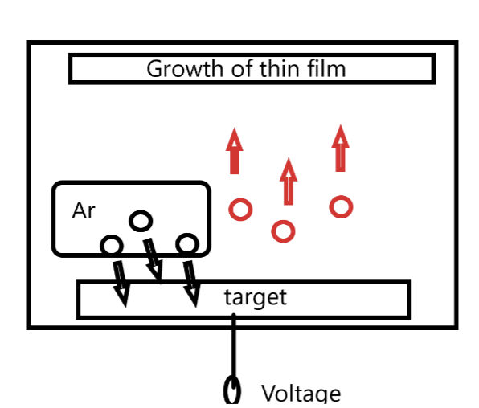
Magnetron sputtering
Notes:
Magnetron sputtering is a very common technique used for a variety of samples with coatings having electrical or magnetic properties [18]. The technique is very versatile as it is easy to deposit many different kinds of materials at a range of different rates while still obtaining a homogeneous surface throughout the sample. There is further a low occurrence of unwanted events and chemical reactions as the process is carried out using noble non-reacting gasses. The technique allows for thicknesses down to a few nanometer which is of huge importance in thin films as a small change in size can have a great impact on the magnetic properties. The magnetron consists of a vacuum chamber filled with an inert gas. Inside the chamber there are different targets, each connected to a high power supply. A negative voltage is applied to create a plasma thanks to the ionization of the inert gas surrounding. Those ions will hit the target and remove target atoms that will sputter upwards onto the sample as seen in fig. 4 A)

Slide 24
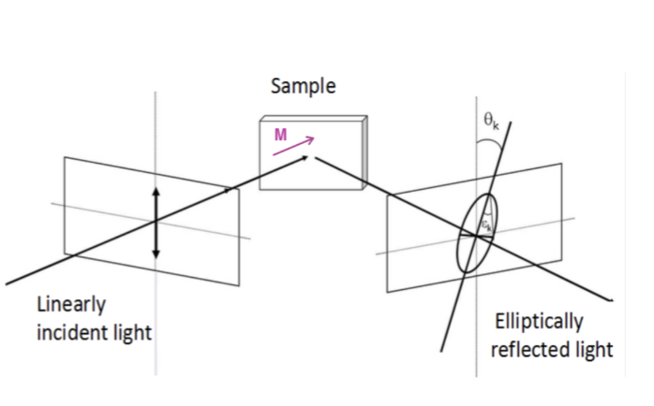
Magneto-optical Kerr effect (MOKE)
Notes:
The magneto-optical Kerr effect (MOKE) is one out of many techniques used for studying spin-related phenomena. It is commonly used when investigating magnetic thin films or surfaces as it can give in- formation about the orientation, uniformity and strength of the magnetization down to the mono-layer resolution [17], [19]. The technique is based on the fact that when an electromagnetic waves like light interacts with a magnetic surface, the polarization and intensity is changed [20]. In MOKE the polarization rotation of the reflected light beam is directly proportional to the magnetization, ⃗ M, of the material [17]. In order to keep track of the change in polarization, one defines the scattering plane also called the plane of incidence as the plane containing both the incident and the reflected light beam. There are 3 possible MOKE geometries which depend on the direction of the magnetization vector with respect to both the sample plane and the scattering plane: longitudinal Kerr effect, transverse Kerr effect, and polar Kerr effect. In the longitudinal Kerr geometry, the magnetization is laying in the sample plane and parallel to the scattering plane. In the polar configuration, the magnetization is perpendicular to the sample plane and parallel to the scattering plane. Lastly, the transverse Kerr effect describes a magnetization which is in the plane of the sample and perpendicular to the scattering plane [17]. The general setup for measuring MOKE consists of a laser source with wavelength in the visi- ble to infrared (IR) range which passes through a polarizer which allows you to select a specific polarization and thereby get a known and completely linear polarized beam in either the s or p direction. s and p are the abbreviations for senkrecht and parallel and refers to the direction of the polarization. s polarized light has an electric field lying perpendicular to the scattering plane and p polarized light has an electric field parallel to to the scattering plane making it orthogonal to s [17]. We assume that a s- polarization is chosen. When the beam is reflected from a metallic and magnetic surface, the polarization can change in 2 ways. The first is the gain of a small p-component which leads to a rotation, θ, from its initial polarization. Second, there is a change in the phase between the s-polarization and p-polarization which leads to an elliptical reflected light whith an ellipticity of, ε [17]. The change in Kerr ellipticity and Kerr rotation are very small quantities and therefore, one needs instruments which can measure them with high sensitivity and that we will describe in the next section.

Slide 25
Atomic force microscopy
Notes:
The atomic force microscopy (AFM) technique is very versatile as it allows one to study the surface of many different types of materials with a high spatial resolution [21]. The AFM technique uses the interaction of a small probe with the surface of interest to produce 2D maps of the topography. The general AFM setup consists of a flexible cantilever with a nm-sized tip at its end. When the tip is close to a surface, interactions will attract or repel the tip which will result in bending the cantilever. A laser is reflected on this cantilever and the angle of reflection is measured by a quadrant photodiode detector which provides a simple way to monitor the tip - surface interactions. One of the reasons for the versatility is the many modes of the AFM. The typical modes for the general AFM setup are the contact mode and tapping mode. In the contact mode, the tip is in constant contact with the surface during the scan while in tapping mode the cantilever is oscillating thanks to a piezo. In tapping mode, the cantilever gently ”taps” the surface, which modifies the oscillations of the cantilever. A feedback loop is then used to change the vertical position of the latter and adjust the amplitude to a constant setpoint value. The measured z position of the scanning head during a measurement thus gives precise information on the topography of the sample, while keeping tip wear to a minimum. Besides mechanical force, the AFM can also use other forces in order to obtain information about electrical, magnetic, chemical, and optical properties [22]. In the electrical modes, a voltage is applied to the cantilever. This mode allows you to look at the conductivity, tunneling current and you can look at how the charges are distributed. In the magnetic mode (magnetic force microscopy (MFM)) a magnetic tip is mounted onto the cantilever which can interact with the stray field of a magnetic sample allowing one to see domains [23]

Slide 26
Scanning electron microscopy (SEM) and energy-dispersive x-ray spectroscopy (EDX)
Notes:
Scanning electron microscopy (SEM) and energy-dispersive x-ray spectroscopy (EDX) are two techniques which are often used together in order to determine both elemental composition as well as to give a picture with a good resolution of the surface down to a few nanometers. SEM is a fast technique to obtain images of the surface structure compared to AFM which is much slower due to it’s ”mechanical” scanning of the surface. However, it does not yield the same information regarding the magnetic properties which is why both techniques are of great importance. SEM is a microscope technique using a beam of electrons which interacts with the sample. After interaction, the electrons will be either back scattered or create secondary electrons and they will further emit characteristic X-ray beam depending on the elemental composition [24]. The back scattering and the secondary electrons are used for producing the surface images and can occur in 2 ways namely by inelastic and elastic interactions. In both cases only the electrons bunched back from the surface will be detected and an image with contrast reflecting the topography of the surface will be produced [24]. The EDX detector is an extension of the SEM and is a precise and fast way to determine the elemental composition and concentration of a sample. The method is based on the fact, that each element has a unique x-ray spectrum. EDX is able to detect atoms with more than 5 protons [24] with an accuracy of maximum around 0.5%.

Slide 27
DATA
Notes:
The aim of this internship was to grow CoTb samples with PMA and magnetic domains with typical size (periodicity) of several hundreds of nanometers. In order to reach this goal, a systematic study of different growth parameters of CoTb alloys was performed. The CoTb alloys was grown on Si wafers and the general structure of the thin film was: Si/Ta3nm or Pt3nm/(Co1−XTbX)Ynm/Pt3nm as seen in fig. 5 A. The different parameters we modified are: • The cleaning procedure of the Si wafer • The kind of buffer used (Ta or Pt) • The thickness Y of Co1−XTbX layer • The deposition rate of the different materials (power of the sources and Ar gas pressure) • The alloy composition, X = 0.08, 0.10, 0.12, 0.15 A total of 33 different samples were made during this internship. I will however only focus on the 19 samples shown in fig 5. This table summarizes the growth parameters. Column 2 shows the systematic sample names, but for the clarity of this report we will use the numbers in column 1 throughout the report. Column 3 indicates how the Si wafer was cleaned before magnetron sputtering. Column 4 indicates if Pt or Ta was used as a buffer. The composition X of Co1−XTbX is shown in column 5 and the grown thickness Y in column 6. Column 7 displays the Ar pressure used during growth (CG1 gauge gives the pressure in 10−3mbar), column 8 is the power applied to the Co source in Watt (W), and Column 9 the deposition rate measured in ̊A/s. All data which are not provided in this report, can be found in supplementary information (SI).

